Slide 1
Principal Component Analysis

Slide 2
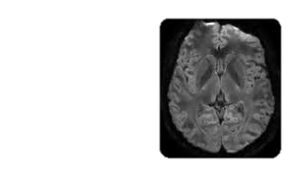
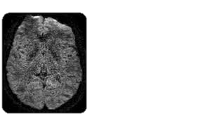


Applications of PCA – Noise Removal
Treat images as matrix and “smoothen” the image by taking a low-rank approximation
If data features are $d$-dim but data is really lying close to some $k≪d$ dim subspace then it may be noise that is making the data $d$-dim
PCA can help extract only the important (hidden) $k$ features in the data which we can then use to classify/do other ML stuff
Given $X∈ℝ^{n×d}$, compute PCA $\hat{X}=\hat{U}\hat{Σ}{\hat{V}}^{⊤}$ and use $\tilde{X}=\hat{U}\hat{Σ}∈ℝ^{n×k}$ as a set of new $k$-dimensional features for the $n$ data points
Training algos would get sped up if used with $k$-dim features instead of $d$-dim
Testing may not get sped up because for a given test point $x^{t}∈ℝ^{d}$, we will first have to find out its $k$-dim representation – would need to compute ${\hat{V}}^{⊤}x^{t}$
Notice that we have $X\hat{V}=UΣV^{⊤}\hat{V}=\hat{U}\hat{Σ}=\tilde{X}$ (since $V$ is orthonormal) so even for training features we can compute $k$-dim rep by just hitting with $\hat{V}$

Slide 3


Foreground Background Separation
$$=$$
$$+$$
3

Slide 4
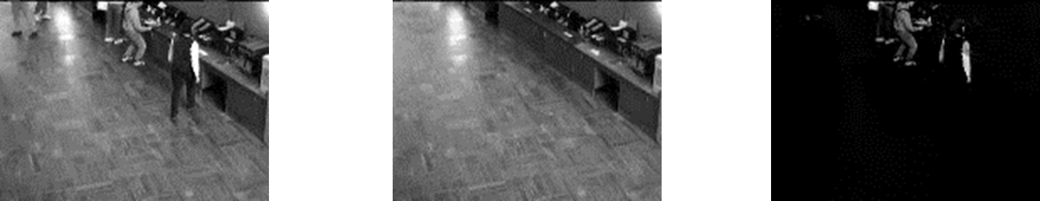
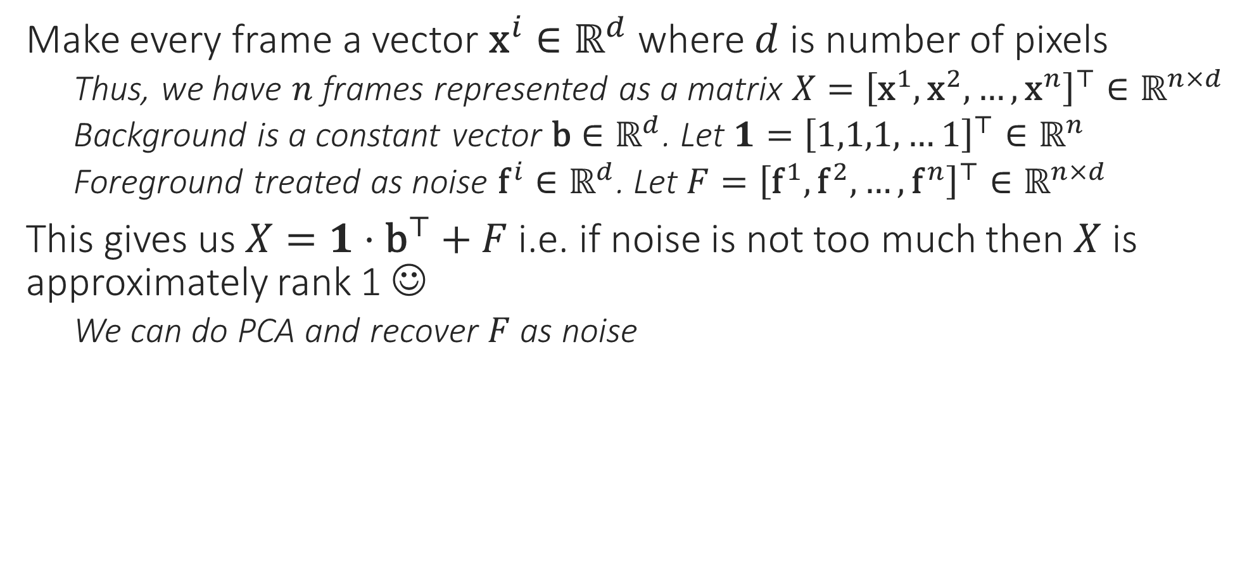
Denoising, Foreground Extraction
Note: here we are treating images as vectors and a group of images (say a video) is treated as a matrix – this is different from the noise removal example where every image was treated as a matrix itself
Make every frame a vector ${\text{x}}^{i}∈ℝ^{d}$ where $d$ is number of pixels
Thus, we have $n$ frames represented as a matrix $X={\left[{\text{x}}^{1},{\text{x}}^{2},…,{\text{x}}^{n}\right]}^{⊤}∈ℝ^{n×d}$
Background is a constant vector $\text{b}∈ℝ^{d}$. Let $1={\left[1,1,1,…1\right]}^{⊤}∈ℝ^{n}$
Foreground treated as noise ${\text{f}}^{i}∈ℝ^{d}$. Let $F={\left[{\text{f}}^{1},{\text{f}}^{2},…,{\text{f}}^{n}\right]}^{⊤}∈ℝ^{n×d}$
This gives us $X=1⋅{\text{b}}^{⊤}+F$ i.e. if noise is not too much then $X$ is approximately rank 1 ☺
We can do PCA and recover $F$ as noise

Slide 5
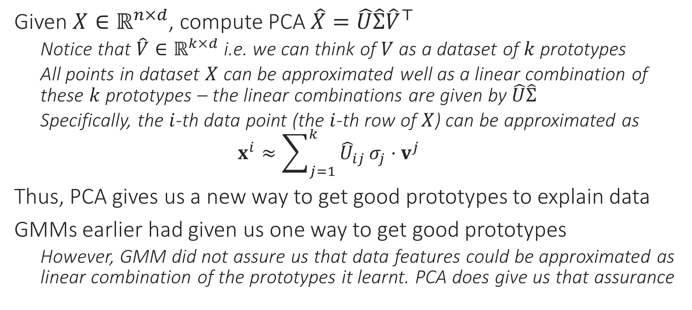
Applications of PCA – Learning Prototypes
Given $X∈ℝ^{n×d}$, compute PCA $\hat{X}=\hat{U}\hat{Σ}{\hat{V}}^{⊤}$
Notice that $\hat{V}∈ℝ^{k×d}$ i.e. we can think of $V$ as a dataset of $k$ prototypes
All points in dataset $X$ can be approximated well as a linear combination of these $k$ prototypes – the linear combinations are given by $\hat{U}\hat{Σ}$
Specifically, the $i$-th data point (the $i$-th row of $X$) can be approximated as $x^{i}≈\sum_{j=1}^{k}{{\hat{U}}_{ij}}σ_{j}⋅v^{j}$
Thus, PCA gives us a new way to get good prototypes to explain data
GMMs earlier had given us one way to get good prototypes
However, GMM did not assure us that data features could be approximated as linear combination of the prototypes it learnt. PCA does give us that assurance

Slide 6
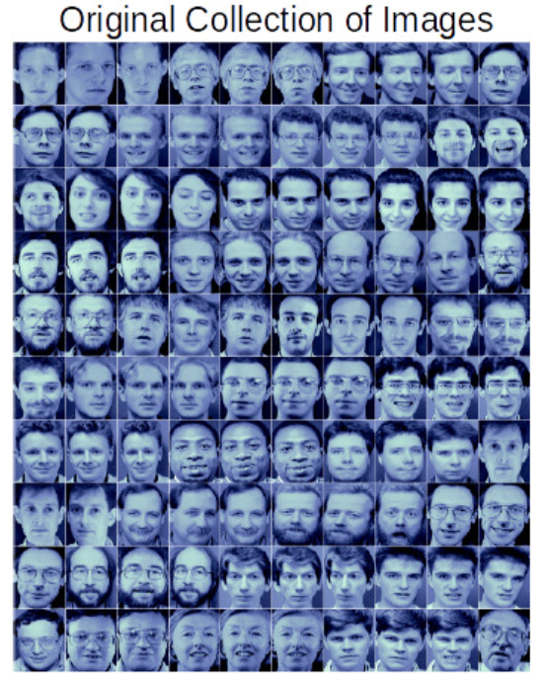
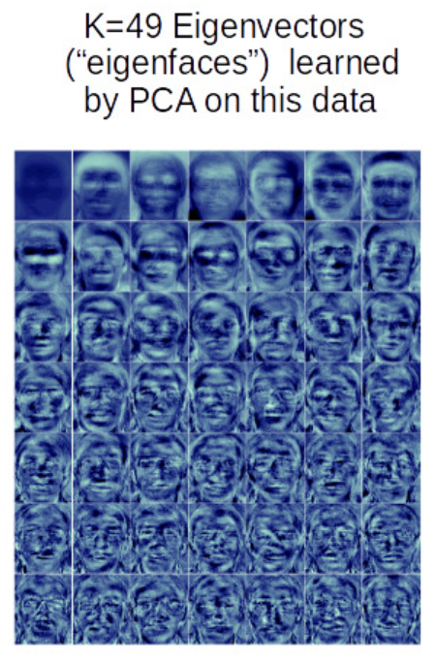
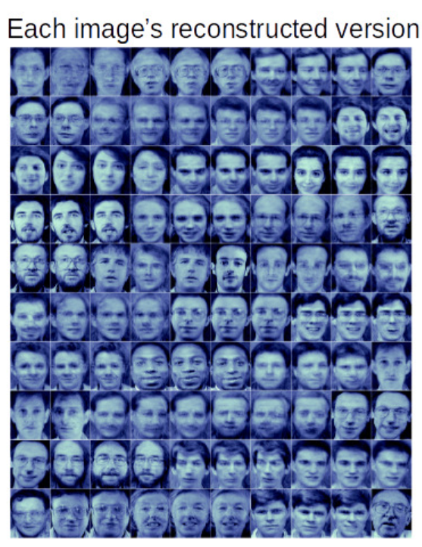
Eigenfaces [Sirovich and Kirby, Turk and Pentland]
Note: here again, we are treating images as vectors and a group of images is treated as a matrix
An iconic application of PCA – given face images, the prototypes given by the leading few right singular vectors are called “eigenfaces”
Images are treated as vectors for this (and many other) application

Slide 7




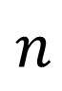
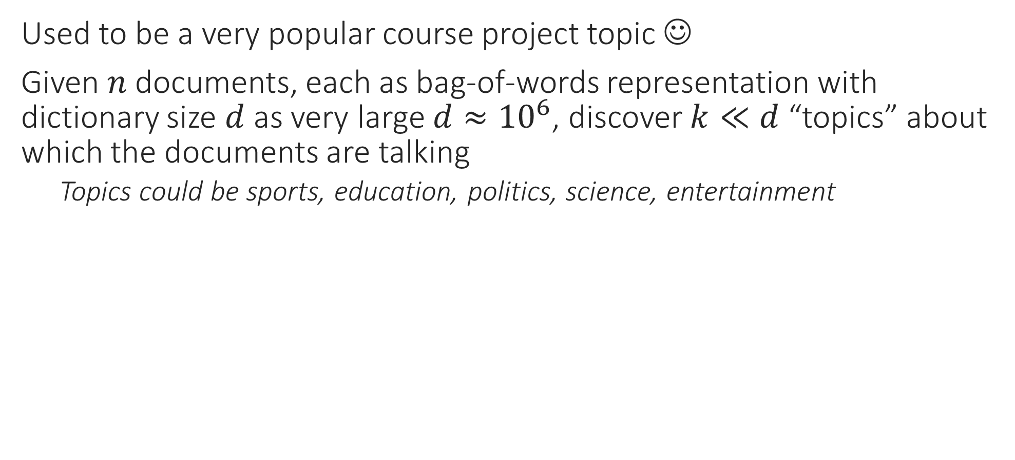







Latent Semantic Analysis (LSA/LSI)
Each topic here is represented by a prototypical document for that topic. All documents are linear representations of the topics. The amount of weight a document places on a certain topic in its representation tells us a lot about what is that document talking about e.g. if $\left|U_{ij}\right|≫1$ then the $j$-th topic is really core to the $i$-th document
Used to be a very popular course project topic ☺
Given $n$ documents, each as bag-of-words representation with dictionary size $d$ as very large $d≈{10}^{6}$, discover $k≪d$ “topics” about which the documents are talking
Topics could be sports, education, politics, science, entertainment
Word of caution: PCA itself will not tell you whether blah prototype is about sports or bleh prototype is about politics. You have to take a look at the prototype vector, also look at documents that place lots of weight on that prototype and make these deductions separately
$d$ words
$k$ topics
$d$ words
$k$ topics
$$≈$$
$n$ docs
$$n$$
$$X$$
$$\hat{U}\hat{Σ}$$
$$\hat{V}$$

Slide 8
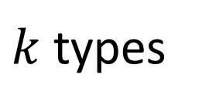
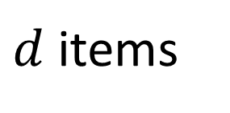
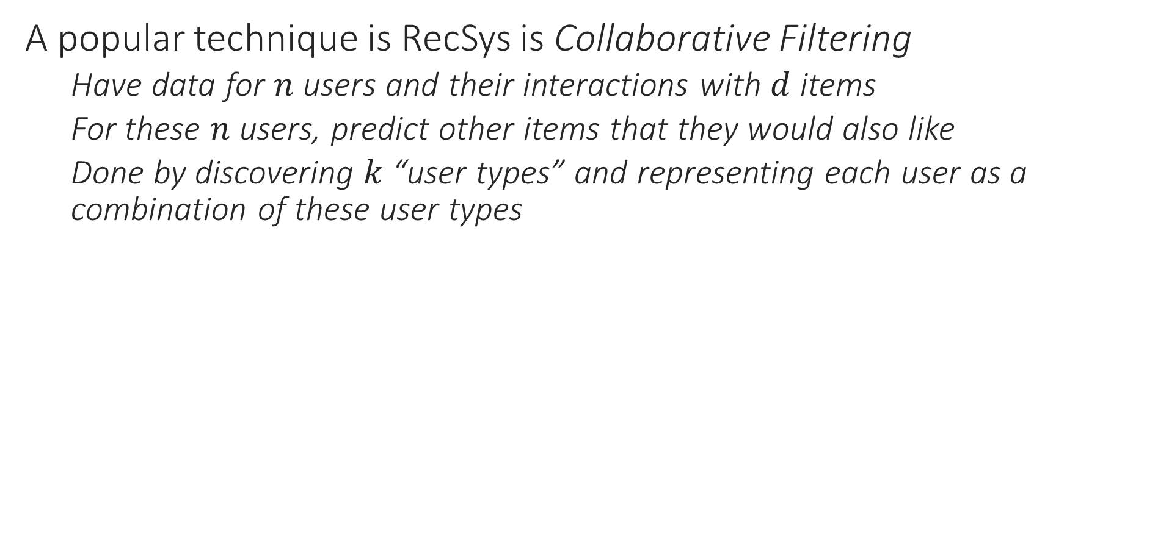
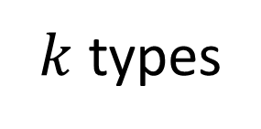
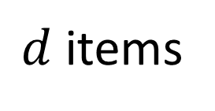

Recommendation Systems
Word of caution: A recommendation system where users have features, is called content-based filtering. However, in the setting in this slide, users have no features. A drawback of collaborative filtering is that it gets more difficult to add new users to the system
A popular technique is RecSys is Collaborative Filtering
Have data for $n$ users and their interactions with $d$ items
For these $n$ users, predict other items that they would also like
Done by discovering $k$ “user types” and representing each user as a combination of these user types
$d$ items
$k$ types
$d$ items
$k$ types
$$≈$$
$n$ users
$$n$$

Slide 9
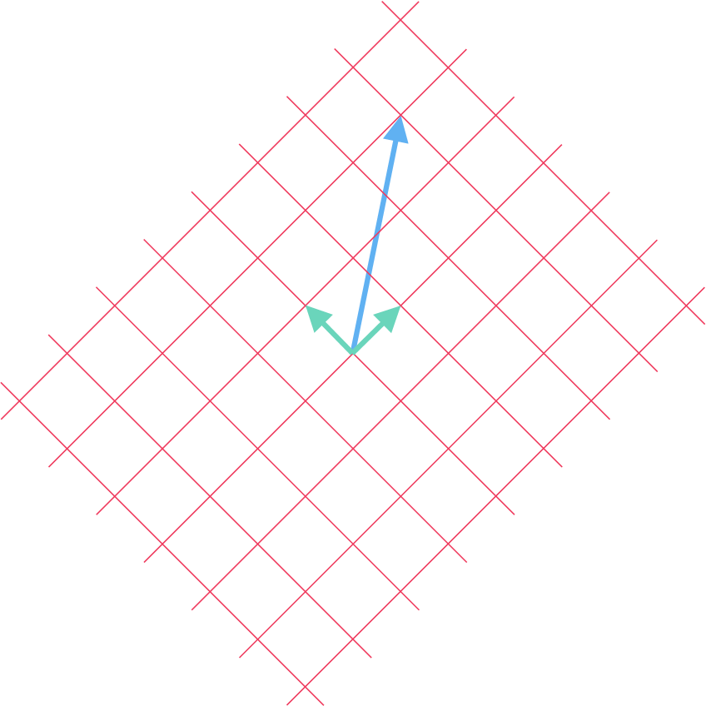
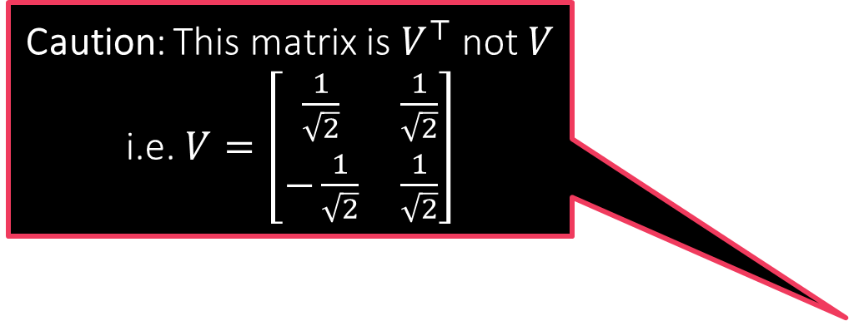


Singular Value Decomposition
Let $A∈ℝ^{d×d}$ be any (possibly non-symmetric) square matrix. Then we can always write $A$ as a product of three matrices $A=UΣV^{⊤}$
where $U,V∈ℝ^{d×d}$ are orthonormal matrices and $Σ$ is a scaling (diagonal) matrix with all entries non-negative
Thus, every linear map is simply a rotation (+ possibly axes flips, swaps), followed by axes scaling followed by another rotation (+ axes flips/swaps)
Caution: This matrix is $V^{⊤}$ not $V$ i.e. $V=\left[\begin{matrix}\frac{1}{\sqrt{2}} & \frac{1}{\sqrt{2}} \\ −\frac{1}{\sqrt{2}} & \frac{1}{\sqrt{2}}\end{matrix}\right]$
clockwise rotation 120
scaling
counter clockwise rotation 45
$A=\left[\begin{matrix}−\frac{1}{2} & \frac{\sqrt{3}}{2} \\ −\frac{\sqrt{3}}{2} & −\frac{1}{2}\end{matrix}\right]⋅\left[\begin{matrix}\frac{3}{4} & 0 \\ 0 & \frac{3}{2}\end{matrix}\right]⋅\left[\begin{matrix}\frac{1}{\sqrt{2}} & −\frac{1}{\sqrt{2}} \\ \frac{1}{\sqrt{2}} & \frac{1}{\sqrt{2}}\end{matrix}\right]$
$A=\frac{3}{8\sqrt{2}}⋅\left[\begin{matrix}2\sqrt{3}−1 & 2\sqrt{3}+1 \\ −2−\sqrt{3} & −2+\sqrt{3}\end{matrix}\right]$

Slide 10


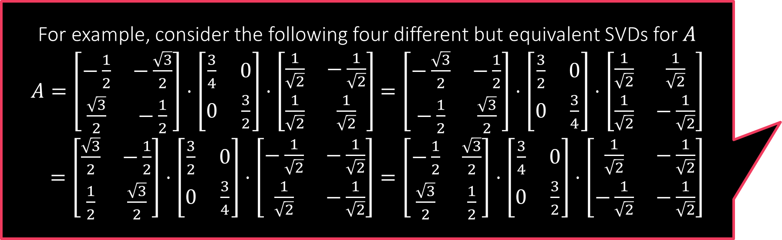

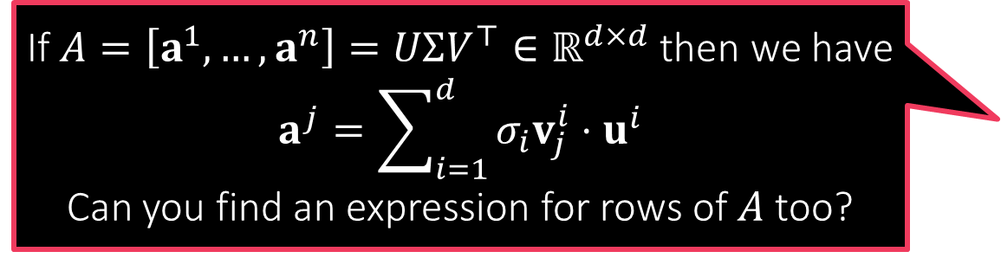

Singular Value Decomposition
For example, consider the following four different but equivalent SVDs for $A$
$A=\left[\begin{matrix}−\frac{1}{2} & −\frac{\sqrt{3}}{2} \\ \frac{\sqrt{3}}{2} & −\frac{1}{2}\end{matrix}\right]⋅\left[\begin{matrix}\frac{3}{4} & 0 \\ 0 & \frac{3}{2}\end{matrix}\right]⋅\left[\begin{matrix}\frac{1}{\sqrt{2}} & −\frac{1}{\sqrt{2}} \\ \frac{1}{\sqrt{2}} & \frac{1}{\sqrt{2}}\end{matrix}\right]$ $=\left[\begin{matrix}−\frac{\sqrt{3}}{2} & −\frac{1}{2} \\ −\frac{1}{2} & \frac{\sqrt{3}}{2}\end{matrix}\right]⋅\left[\begin{matrix}\frac{3}{2} & 0 \\ 0 & \frac{3}{4}\end{matrix}\right]⋅\left[\begin{matrix}\frac{1}{\sqrt{2}} & \frac{1}{\sqrt{2}} \\ \frac{1}{\sqrt{2}} & −\frac{1}{\sqrt{2}}\end{matrix}\right]$
$=\left[\begin{matrix}\frac{\sqrt{3}}{2} & −\frac{1}{2} \\ \frac{1}{2} & \frac{\sqrt{3}}{2}\end{matrix}\right]⋅\left[\begin{matrix}\frac{3}{2} & 0 \\ 0 & \frac{3}{4}\end{matrix}\right]⋅\left[\begin{matrix}−\frac{1}{\sqrt{2}} & −\frac{1}{\sqrt{2}} \\ \frac{1}{\sqrt{2}} & −\frac{1}{\sqrt{2}}\end{matrix}\right]=\left[\begin{matrix}−\frac{1}{2} & \frac{\sqrt{3}}{2} \\ \frac{\sqrt{3}}{2} & \frac{1}{2}\end{matrix}\right]⋅\left[\begin{matrix}\frac{3}{4} & 0 \\ 0 & \frac{3}{2}\end{matrix}\right]⋅\left[\begin{matrix}\frac{1}{\sqrt{2}} & −\frac{1}{\sqrt{2}} \\ −\frac{1}{\sqrt{2}} & −\frac{1}{\sqrt{2}}\end{matrix}\right]$
$A=UΣV^{⊤}$
Diagonal elements in $Σ$ are called the singular values of $A$ (always $≥0$)
Column vectors of $U$ are called the left singular vectors of $A$
Column vectors of $V$ (row vecs of $V^{⊤}$) called right singular vectors of $A$
If $U=\left[u^{1},…,u^{d}\right],V=\left[v^{1},…,v^{d}\right],Σ=diag(σ_{1},…,σ_{d})$, then $A=\sum_{j=1}^{d}{σ_{j}}u^{j}{\left(v^{j}\right)}^{⊤}$
Singular values of a matrix are always unique, singular vectors are not
Given one set of left+right singular vectors, can obtain other sets of left+right singular vectors using “certain” orthonormal maps – details a bit tedious
Tons of things to study about singular decompositions – too little time
Note that each matrix $u^{j}{\left(v^{j}\right)}^{⊤}$ has unit (row and column) rank
In order to minimize this ambiguity, people commonly write SVD such that $Σ=diag(σ_{1},…,σ_{d})$ and $σ_{1}≥σ_{2}≥…$
If $A=\left[a^{1},…,a^{n}\right]=UΣV^{⊤}∈ℝ^{d×d}$ then we have $$a^{j}=\sum_{i=1}^{d}{σ_{i}v_{j}^{i}}⋅u^{i}$$
Can you find an expression for rows of $A$ too?

Slide 11






Singular Value Decomposition
SVD is defined even for matrices that are not square
Suppose $A∈ℝ^{m×n}$ then we can always write $A=UΣV^{⊤}$ where
$U∈ℝ^{m×m}$ and $V∈ℝ^{n×n}$ are orthonormal matrices of different sizes
$Σ∈ℝ^{m×n}$ is a rectangular diagonal matrix with $Σ_{ii}≥0$ but $Σ_{ij}=0$ for $i≠j$
Case 1: $n>m$ i.e. output dim < input dim i.e. $A$ reduces dim of vectors
In this case $Σ$ throws out last $n−m$ dimensions after rotation by $V^{⊤}$
$$A$$
$${ΣV}^{⊤}$$
$$V^{⊤}$$
$$x$$
$$A$$
$$=$$
$$U$$
$$Σ$$
$$V^{⊤}$$

Slide 12





Singular Value Decomposition
SVD is defined even for matrices that are not square
Suppose $A∈ℝ^{m×n}$ then we can always write $A=UΣV^{⊤}$ where
$U∈ℝ^{m×m}$ and $V∈ℝ^{n×n}$ are orthonormal matrices of different sizes
$Σ∈ℝ^{m×n}$ is a rectangular diagonal matrix with $Σ_{ii}≥0$ but $Σ_{ij}=0$ for $i≠j$
Case 2: $n<m$ i.e. output dim > input dim. $A$ increases dim of vectors
In this case $Σ$ adds $n−m$ dummy dimensions in addition to scaling
$$A$$
$${ΣV}^{⊤}$$
$$V^{⊤}$$
$$x$$
$$A$$
$$U$$
$$Σ$$
$$V^{⊤}$$
$$=$$
0
0
0
0

Slide 13
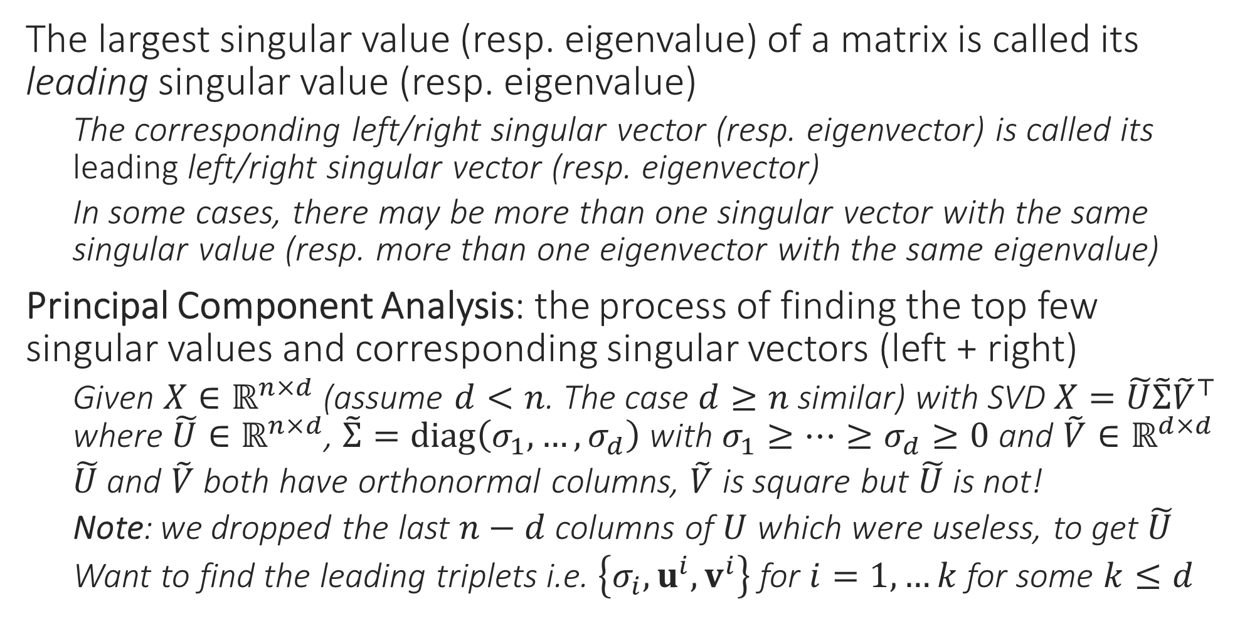
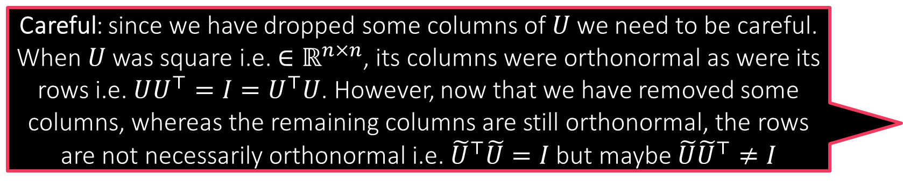
Principal Component Analysis
Careful: since we have dropped some columns of $U$ we need to be careful. When $U$ was square i.e. ${∈ℝ}^{n×n}$, its columns were orthonormal as were its rows i.e. $UU^{⊤}=I=U^{⊤}U$. However, now that we have removed some columns, whereas the remaining columns are still orthonormal, the rows are not necessarily orthonormal i.e. ${\tilde{U}}^{⊤}\tilde{U}=I$ but maybe $\tilde{U}{\tilde{U}}^{⊤}≠I$
The largest singular value (resp. eigenvalue) of a matrix is called its leading singular value (resp. eigenvalue)
The corresponding left/right singular vector (resp. eigenvector) is called its leading left/right singular vector (resp. eigenvector)
In some cases, there may be more than one singular vector with the same singular value (resp. more than one eigenvector with the same eigenvalue)
Principal Component Analysis: the process of finding the top few singular values and corresponding singular vectors (left + right)
Given $X∈ℝ^{n×d}$ (assume $d<n$. The case $d≥n$ similar) with SVD $X=\tilde{U}\tilde{Σ}{\tilde{V}}^{⊤}$ where $\tilde{U}∈ℝ^{n×d}$, $\tilde{Σ}=diag\left(σ_{1},…,σ_{d}\right)$ with $σ_{1}≥…≥σ_{d}≥0$ and $\tilde{V}∈ℝ^{d×d}$
$\tilde{U}$ and $\tilde{V}$ both have orthonormal columns, $\tilde{V}$ is square but $\tilde{U}$ is not!
Note: we dropped the last $n−d$ columns of $U$ which were useless, to get $\tilde{U}$
Want to find the leading triplets i.e. $\left\{σ_{i},u^{i},v^{i}\right\}$ for $i=1,…k$ for some $k≤d$

Slide 14
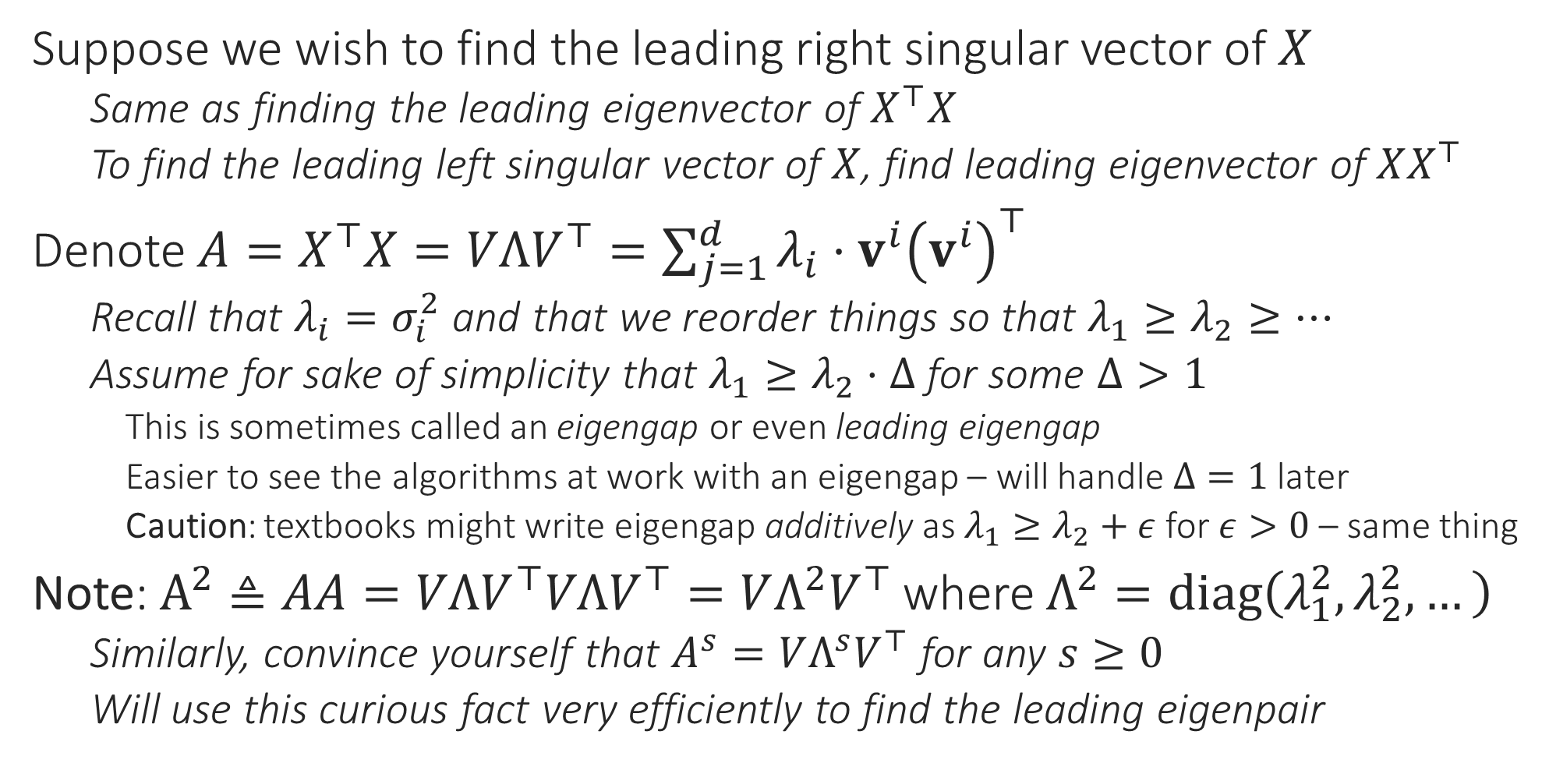
Principal Component Analysis
Suppose we wish to find the leading right singular vector of $X$
Same as finding the leading eigenvector of $X^{⊤}X$
To find the leading left singular vector of $X$, find leading eigenvector of $XX^{⊤}$
Denote $A=X^{⊤}X=VΛV^{⊤}=\sum_{j=1}^{d}{λ_{i}⋅v^{i}{\left(v^{i}\right)}^{⊤}}$
Recall that $λ_{i}=σ_{i}^{2}$ and that we reorder things so that $λ_{1}≥λ_{2}≥…$
Assume for sake of simplicity that $λ_{1}≥λ_{2}⋅Δ$ for some $Δ>1$
This is sometimes called an eigengap or even leading eigengap
Easier to see the algorithms at work with an eigengap – will handle $Δ=1$ later
Caution: textbooks might write eigengap additively as $λ_{1}≥λ_{2}+ε$ for $ε>0$ – same thing
Note: $A^{2}≜AA=VΛV^{⊤}VΛV^{⊤}=VΛ^{2}V^{⊤}$ where $Λ^{2}=diag\left(λ_{1}^{2},λ_{2}^{2},…\right)$
Similarly, convince yourself that $A^{s}=VΛ^{s}V^{⊤}$ for any $s≥0$
Will use this curious fact very efficiently to find the leading eigenpair

Slide 15


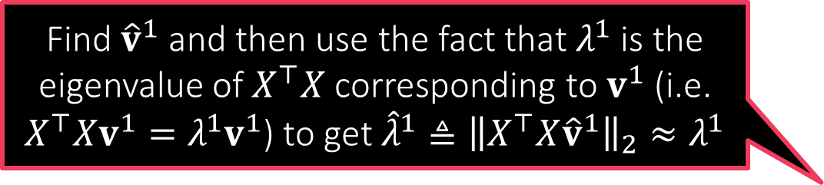




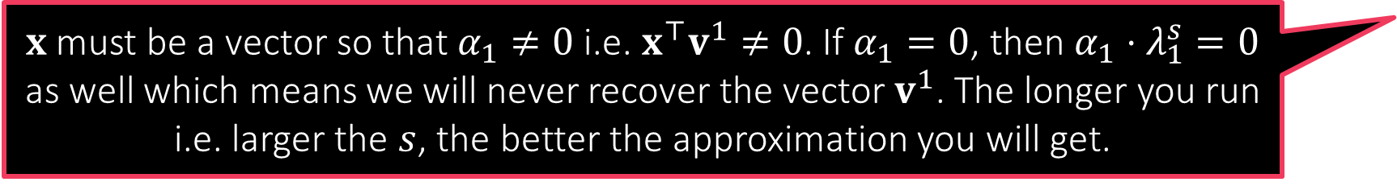


The Power Method
How do I find our $λ_{1}$?
Note that if $λ_{1}≥λ_{2}⋅Δ$, then $λ_{1}^{s}≥λ_{2}^{s}⋅Δ^{s}$ for $s≥1$
Note that this means $λ_{1}^{s}≥λ_{j}^{s}⋅Δ^{s}$ for all $j≥2$ as well
Even if $Δ=1.1$, with large enough $s$, gap blows up e.g. ${1.1}^{100}>10000$
Thus, with large $s$, the leading eigenvalue really stands out!
Let us take a vector $x∈ℝ^{d}$ and let $α=V^{⊤}x$
The vector $α$ represents $x$ in terms of columns of $V$ i.e. $x=\sum_{j=1}^{d}{α_{j}⋅v^{j}}$
Notice that since $V$ is orthonormal, we have $VV^{⊤}x=x$
This means $A^{s}x=VΛ^{s}V^{⊤}x=VΛ^{s}α=$
However, we just saw that $λ_{1}^{s}≫λ_{j}^{s}$ for all $j≥2$
This means that $A^{s}x≈α_{1}λ_{1}^{s}⋅v^{1}$ which means that ${\hat{v}}^{1}≜\frac{A^{s}x}{{\left\|A^{s}x\right\|}_{2}}≈v^{1}$
Hmm … this means if our approximation ${\hat{v}}^{1}$ is not good then our approximation ${\hat{λ}}^{1}$ wont be good either
Find ${\hat{v}}^{1}$ and then use the fact that $λ^{1}$ is the eigenvalue of $X^{⊤}X$ corresponding to $v^{1}$ (i.e. $X^{⊤}Xv^{1}=λ^{1}v^{1}$) to get ${\hat{λ}}^{1}≜{\left\|X^{⊤}X{\hat{v}}^{1}\right\|}_{2}≈λ^{1}$
$x$ must be a vector so that $α_{1}≠0$ i.e. $x^{⊤}v^{1}≠0$. If $α_{1}=0$, then $α_{1}⋅λ_{1}^{s}=0$ as well which means we will never recover the vector $v^{1}$. The longer you run i.e. larger the $s$, the better the approximation you will get.
$$α_{1}λ_{1}^{s}⋅v^{1}+$$
$\sum_{j>1}{α_{j}λ_{j}^{s}⋅v^{j}}$
We obtained our approximation as ${\hat{v}}^{1}≜\frac{A^{s}x}{{\left\|A^{s}x\right\|}_{2}}$. How should we choose $x$? Will any $x$ work? How should we choose $s$?

Slide 16
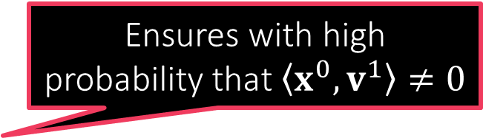
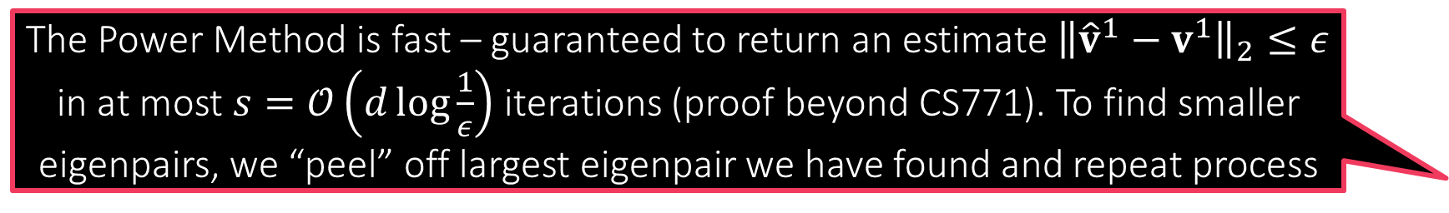


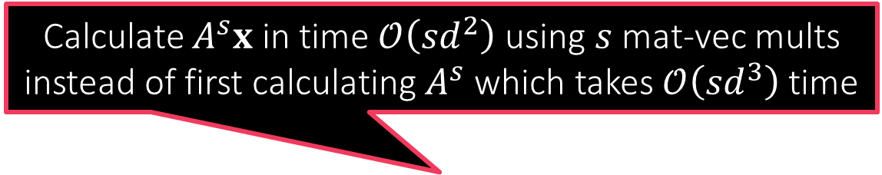

The Power Method
THE POWER METHOD
Input: square symmetric matrix $A∈ℝ^{d×d}$
Initialize $x^{0}$ randomly e.g. $∼𝒩(0,I)$
For $t=1,2,…,s$
Let $z^{t}=Ax^{t−1}$
Let $x^{t}=z^{t}$
Return leading eigenvector estimate as ${\hat{v}}^{1}=x^{s}$
Return leading eigenvalue estimate as ${{\hat{λ}}_{1}=\left\|A{\hat{v}}^{1}\right\|}_{2}$
Calculate $A^{s}x$ in time $𝒪\left(sd^{2}\right)$ using $s$ mat-vec mults instead of first calculating $A^{s}$ which takes $𝒪\left({sd}^{3}\right)$ time
Ensures with high probability that $\left\langle x^{0},v^{1}\right\rangle ≠0$
Good to periodically normalize to prevent overflow errors
$$/{\left\|z^{t}\right\|}_{2}$$
Can show that doesn’t affect the working of the algo in any way
$$/{\left\|x^{s}\right\|}_{2}$$
The Power Method is fast – guaranteed to return an estimate ${\left\|{\hat{v}}^{1}−v^{1}\right\|}_{2}≤ε$ in at most $s=𝒪\left(d\log{\frac{1}{ε}}\right)$ iterations (proof beyond CS771). To find smaller eigenpairs, we “peel” off largest eigenpair we have found and repeat process
In settings with no eigengap, it turns out that there is an entire subspace (i.e. infinitely many eigenvectors) corresponding to the largest eigenvalue
Power Method will return some vector in that subspace but not sure which

Slide 17


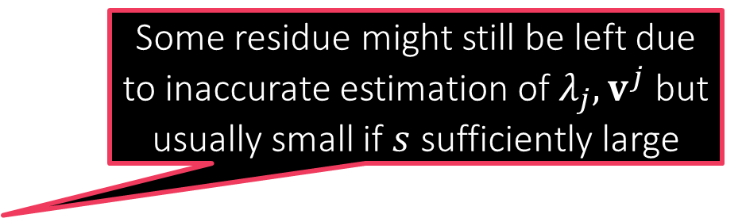
The Peeling Method
THE PEELING METHOD
Input: square symmetric matrix $A∈ℝ^{d×d}$
Initialize $A^{0}←A$
For $j=1,…,k$
Let $\left({\hat{λ}}_{j},{\hat{v}}_{j}\right)←\text{POWER}\text{−}\text{METHOD}\left(A^{j−1}\right)$
Let $A^{j}←A^{j−1}−{\hat{λ}}_{j}⋅{\hat{v}}_{j}{\left({\hat{v}}_{j}\right)}^{⊤}$
Return ${\left\{{\hat{λ}}_{j},{\hat{v}}_{j}\right\}}_{j=1}^{k}$
Takes overall $𝒪\left(kd^{2}s\right)$ time to return the top $k$ leading eigenpairs of $A$
The “peeling” step
After leading eigenpair is peeled off, the eigenpair with the second largest eigenvalue becomes the new leading pair and Power Method can now recover this
Some residue might still be left due to inaccurate estimation of $λ_{j},v^{j}$ but usually small if $s$ sufficiently large
$$A=λ_{1}{\text{v}}^{1}{\left({\text{v}}^{1}\right)}^{⊤}+λ_{2}{\text{v}}^{2}{\left({\text{v}}^{2}\right)}^{⊤}+λ_{3}{\text{v}}^{3}{\left({\text{v}}^{3}\right)}^{⊤}+λ_{4}{\text{v}}^{4}{\left({\text{v}}^{4}\right)}^{⊤}+…$$

Slide 18

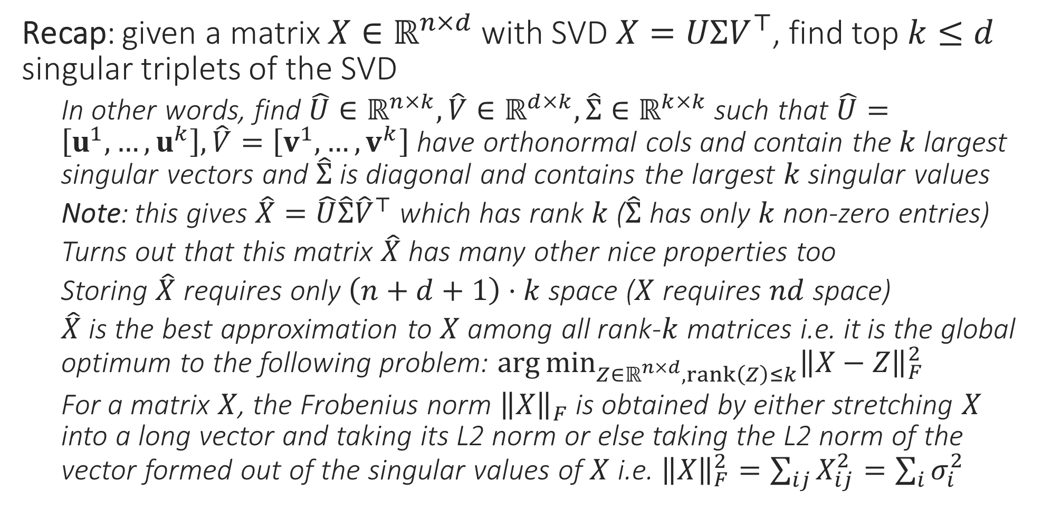
PCA – the inside story
Recap: given a matrix $X∈ℝ^{n×d}$ with SVD $X=UΣV^{⊤}$, find top $k≤d$ singular triplets of the SVD
In other words, find $\hat{U}∈ℝ^{n×k},\hat{V}∈ℝ^{d×k},\hat{Σ}∈ℝ^{k×k}$ such that $\hat{U}=\left[u^{1},…,u^{k}\right],\hat{V}=\left[v^{1},…,v^{k}\right]$ have orthonormal cols and contain the $k$ largest singular vectors and $\hat{Σ}$ is diagonal and contains the largest $k$ singular values
Note: this gives $\hat{X}=\hat{U}\hat{Σ}{\hat{V}}^{⊤}$ which has rank $k$ ($\hat{Σ}$ has only $k$ non-zero entries)
Turns out that this matrix $\hat{X}$ has many other nice properties too
Storing $\hat{X}$ requires only $\left(n+d+1\right)⋅k$ space ($X$ requires $nd$ space)
$\hat{X}$ is the best approximation to $X$ among all rank-$k$ matrices i.e. it is the global optimum to the following problem: $\arg{\min_{Z∈ℝ^{n×d},rank\left(Z\right)≤k}{{\left\|X−Z\right\|}_{F}^{2}}}$
For a matrix $X$, the Frobenius norm ${\left\|X\right\|}_{F}$ is obtained by either stretching $X$ into a long vector and taking its L2 norm or else taking the L2 norm of the vector formed out of the singular values of $X$ i.e. ${\left\|X\right\|}_{F}^{2}=\sum_{ij}{X_{ij}^{2}}=\sum_{i}{σ_{i}^{2}}$
Rows of $\hat{U},\hat{V}$ not necessarily orthonormal

Slide 19
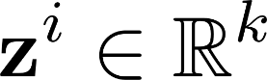
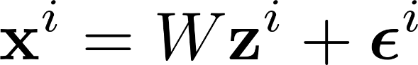
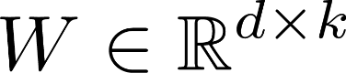
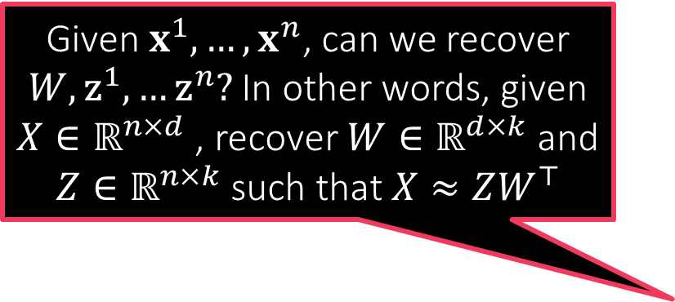



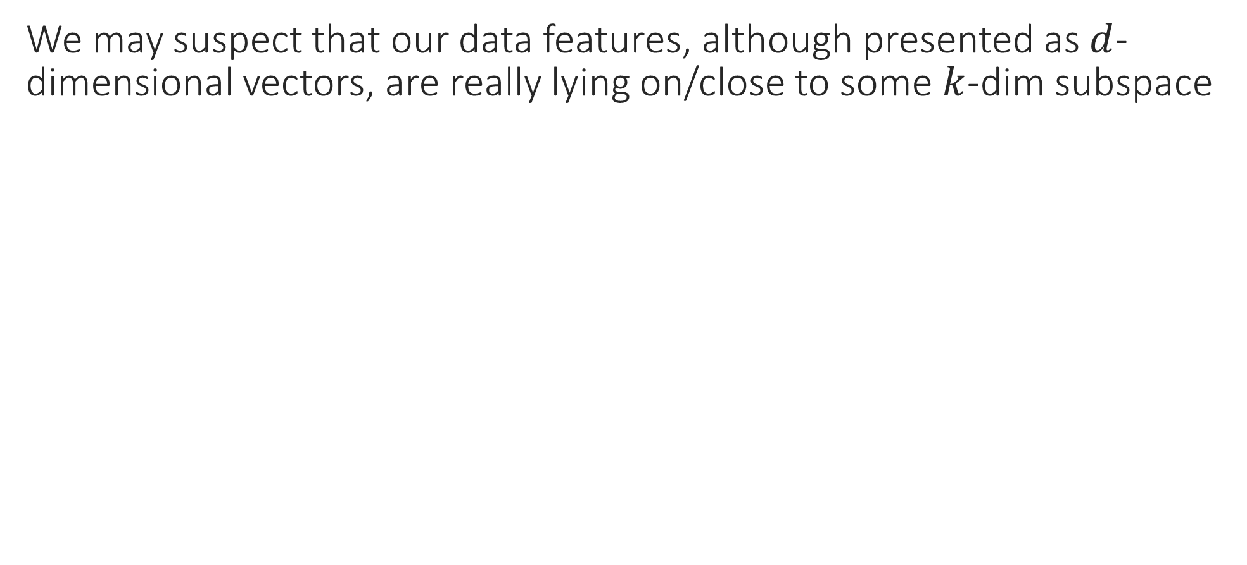

Low dimensional Modelling
PCA can help you solve this problem. Find $\hat{U},\hat{V},\hat{Σ}$ and set $Z=\hat{U} \hat{Σ}$ and $W=\hat{V}$. As noted earlier, it will give us the best possible approximation any $W,Z$ with only $k$ columns could have given
We may suspect that our data features, although presented as $d$-dimensional vectors, are really lying on/close to some $k$-dim subspace
Given $x^{1},…,x^{n}$, can we recover $W,{\text{z}}^{1},…{\text{z}}^{n}?$ In other words, given $X∈ℝ^{n×d}$ , recover $W∈ℝ^{d×k}$ and $Z∈ℝ^{n×k}$ such that $X≈ZW^{⊤}$
$$x^{i}$$
$$W$$
$$z^{i}$$
=
Dictionary/Factor Loading matrix

Slide 20

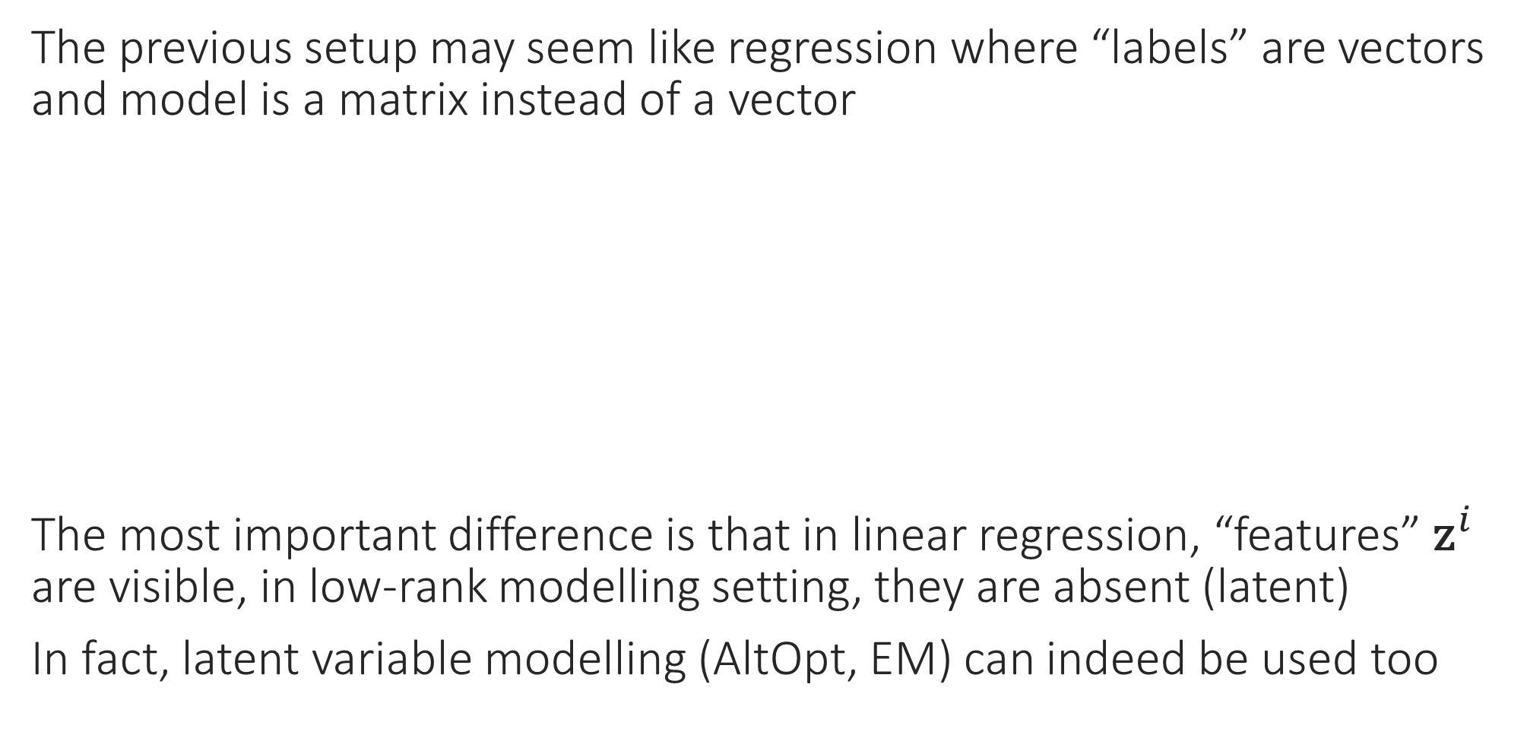

PCA vs Regression
The previous setup may seem like regression where “labels” are vectors and model is a matrix instead of a vector
The most important difference is that in linear regression, “features” ${\text{z}}^{i}$ are visible, in low-rank modelling setting, they are absent (latent)
In fact, latent variable modelling (AltOpt, EM) can indeed be used too
Linear Regression
${\text{z}}^{i}∈ℝ^{k}$,
$y^{i}=\left\langle \text{w},{\text{z}}^{i}\right\rangle +ε^{i}$
$\text{w}∈ℝ^{k}$
$ε^{i}∈ℝ$
Observed data $\left({\text{z}}^{i},y^{i}\right)∈ℝ^{k}×ℝ$
Low-rank Modelling
${\text{z}}^{i}∈ℝ^{k}$,
${\text{x}}^{i}=W{\text{z}}^{i}+ε^{i}$
$W∈ℝ^{d×k}$
$ε^{i}∈ℝ^{d}$
Observed data ${\text{x}}^{i}∈ℝ^{d}$

Slide 21
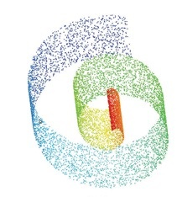
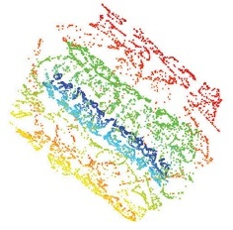
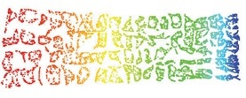
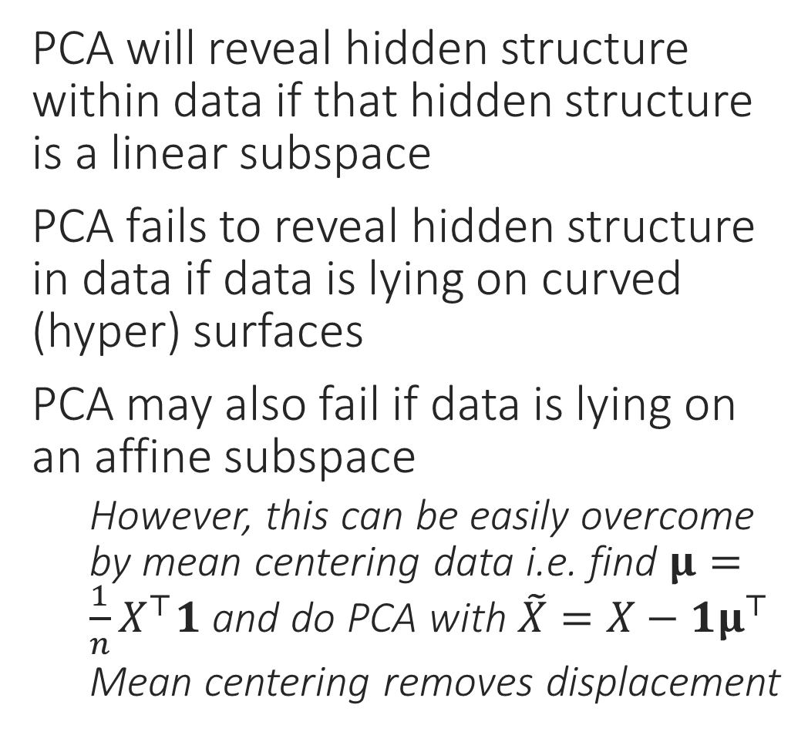
Shortcomings of PCA
What PCA will give us
PCA will reveal hidden structure within data if that hidden structure is a linear subspace
PCA fails to reveal hidden structure in data if data is lying on curved (hyper) surfaces
PCA may also fail if data is lying on an affine subspace
However, this can be easily overcome by mean centering data i.e. find $μ=\frac{1}{n}X^{⊤}1$ and do PCA with $\tilde{X}=X−1μ^{⊤}$
Mean centering removes displacement
“Swiss Roll” data – used to be very popular in ML
What we really want

Slide 22
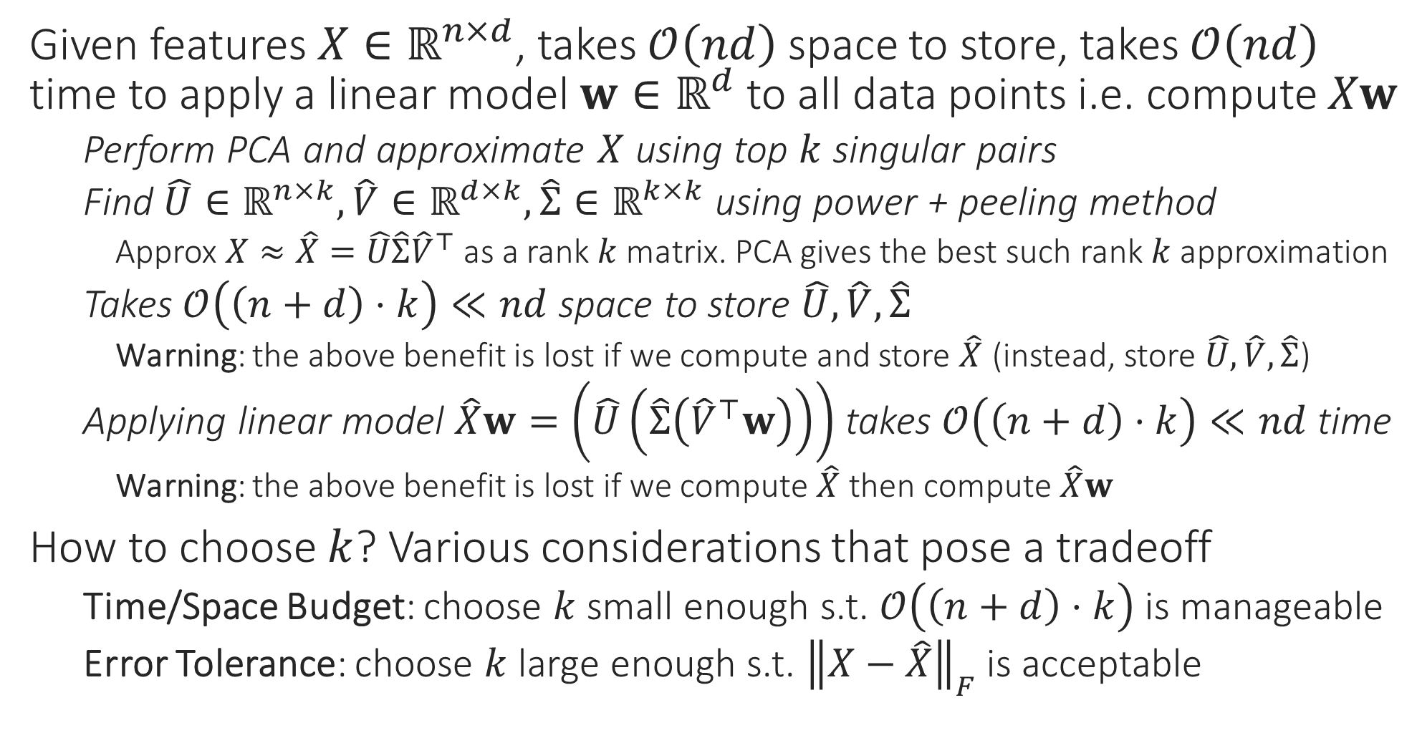

Applications of PCA – Space Savings
Is there are quick way to find whether ${\left\|X−\hat{X}\right\|}_{F}$ is small or not?
Given features $X∈ℝ^{n×d}$, takes $𝒪\left(nd\right)$ space to store, takes $𝒪\left(nd\right)$ time to apply a linear model $w∈ℝ^{d}$ to all data points i.e. compute $Xw$
Perform PCA and approximate $X$ using top $k$ singular pairs
Find $\hat{U}∈ℝ^{n×k},\hat{V}∈ℝ^{d×k},\hat{Σ}∈ℝ^{k×k}$ using power + peeling method
Approx $X≈\hat{X}=\hat{U}\hat{Σ}{\hat{V}}^{⊤}$ as a rank $k$ matrix. PCA gives the best such rank $k$ approximation
Takes $𝒪\left(\left(n+d\right)⋅k\right)≪nd$ space to store $\hat{U},\hat{V},\hat{Σ}$
Warning: the above benefit is lost if we compute and store $\hat{X}$ (instead, store $\hat{U},\hat{V},\hat{Σ}$)
Applying linear model $\hat{X}w=\left(\hat{U}\left(\hat{Σ}\left({\hat{V}}^{⊤}w\right)\right)\right)$ takes $𝒪\left(\left(n+d\right)⋅k\right)≪nd$ time
Warning: the above benefit is lost if we compute $\hat{X}$ then compute $\hat{X}w$
How to choose $k$? Various considerations that pose a tradeoff
Time/Space Budget: choose $k$ small enough s.t. $𝒪\left(\left(n+d\right)⋅k\right)$ is manageable
Error Tolerance: choose $k$ large enough s.t. ${\left\|X−\hat{X}\right\|}_{F}$ is acceptable

Slide 23




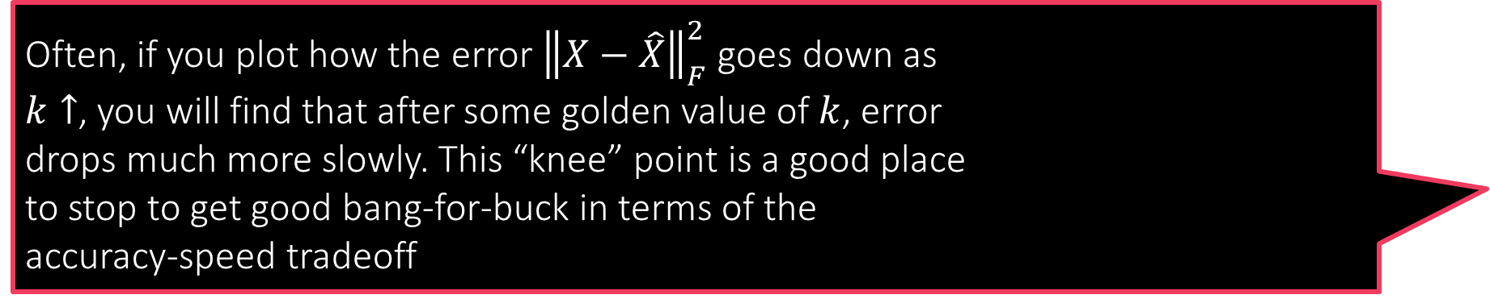

Finding the right value of $k$
So, first find ${\left\|X\right\|}_{F}^{2}=\sum_{j=1}^{d}{σ_{j}^{2}}$. Then, once you have a PCA for some value of $k$, compute the squared sum of singular values you have got i.e. $\sum_{j=1}^{k}{σ_{j}^{2}}$. Use this to get $\sum_{j=k+1}^{d}{σ_{j}^{2}}={\left\|X−\hat{X}\right\|}_{F}^{2}$
For $d<n$, we have $X=\sum_{j=1}^{d}{σ_{j}u^{j}{\left(v^{j}\right)}^{⊤}}$ and $\hat{X}=\sum_{j=1}^{k}{σ_{j}u^{j}{\left(v^{j}\right)}^{⊤}}$
Thus, ignoring peeling errors, we get $X−\hat{X}=\sum_{j=k+1}^{d}{σ_{j}u^{j}{\left(v^{j}\right)}^{⊤}}$
Fact: ${\left\|A\right\|}_{F}^{2}=tr\left(A^{⊤}A\right)=tr\left(AA^{⊤}\right)$ where $tr$ is the trace (sum of diagonal)
${\left\|X−\hat{X}\right\|}_{F}^{2}=tr\left(\sum_{j=k+1}^{d}{σ_{j}^{2}v^{j}{\left(u^{j}\right)}^{⊤}u^{j}{\left(v^{j}\right)}^{⊤}}+\sum_{j≠l}{σ_{j}σ_{l}v^{j}{\left(u^{j}\right)}^{⊤}u^{l}{\left(v^{l}\right)}^{⊤}}\right)$
Now $u^{j}$ are orthonormal and so are $v^{j}$ i.e. ${\left(u^{j}\right)}^{⊤}u^{l}=0$ and ${\left(u^{j}\right)}^{⊤}u^{j}=1$
${\left\|X−\hat{X}\right\|}_{F}^{2}=tr\left(\sum_{j=k+1}^{d}{σ_{j}^{2}v^{j}{\left(v^{j}\right)}^{⊤}}\right)=\sum_{j=k+1}^{d}{σ_{j}^{2}tr\left(v^{j}{\left(v^{j}\right)}^{⊤}\right)}=\sum_{j=k+1}^{d}{σ_{j}^{2}}$
Used linearity of trace and $tr\left(v^{j}{\left(v^{j}\right)}^{⊤}\right)=tr\left({{\left(v^{j}\right)}^{⊤}v}^{j}\right)=1$ to show this
Similarly, can show that ${\left\|X\right\|}_{F}^{2}=\sum_{j=1}^{d}{σ_{j}^{2}}$
A prominent knee point, if one exists, gives us a good idea of the true intrinsic dimensionality of the data
Often, if you plot how the error ${\left\|X−\hat{X}\right\|}_{F}^{2}$ goes down as $k↑$, you will find that after some golden value of $k$, error drops much more slowly. This “knee” point is a good place to stop to get good bang-for-buck in terms of the accuracy-speed tradeoff
“knee” point
$${\left\|X−\hat{X}\right\|}_{F}^{2}$$
$$k$$

Slide 24
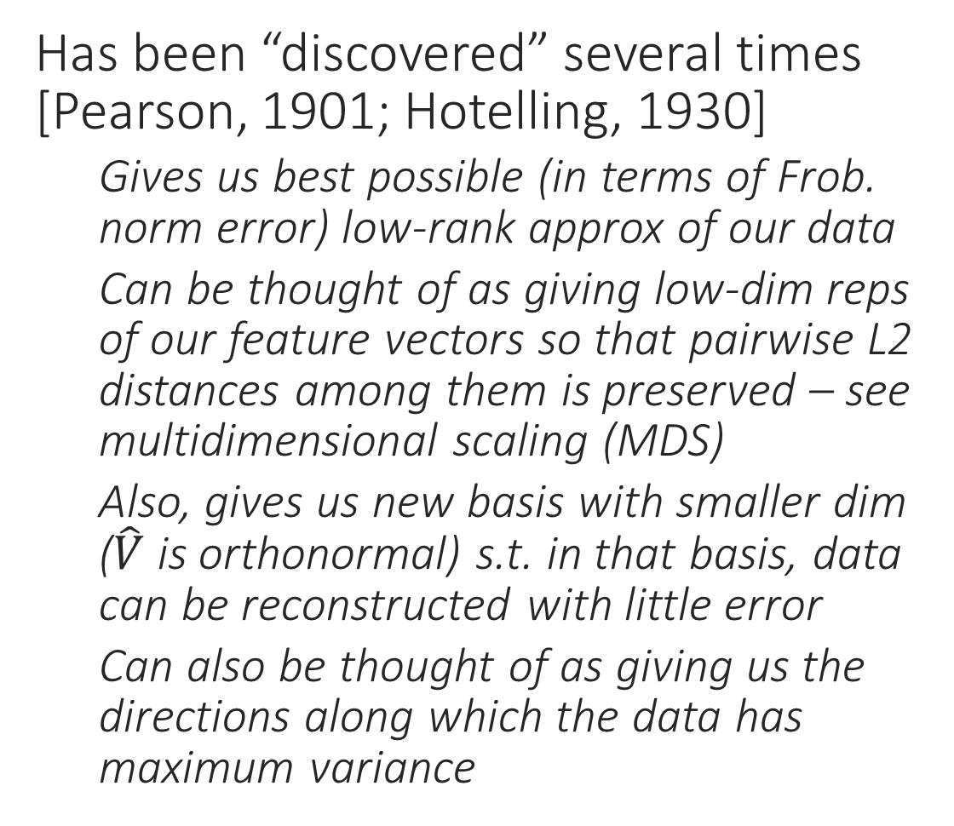
The Many Faces of PCA
Has been “discovered” several times [Pearson, 1901; Hotelling, 1930]
Gives us best possible (in terms of Frob. norm error) low-rank approx of our data
Can be thought of as giving low-dim reps of our feature vectors so that pairwise L2 distances among them is preserved – see multidimensional scaling (MDS)
Also, gives us new basis with smaller dim ($\hat{V}$ is orthonormal) s.t. in that basis, data can be reconstructed with little error
Can also be thought of as giving us the directions along which the data has maximum variance
This line captures most of the information in the data Why not get rid of the other information? Save space, reduce noise!

Slide 25
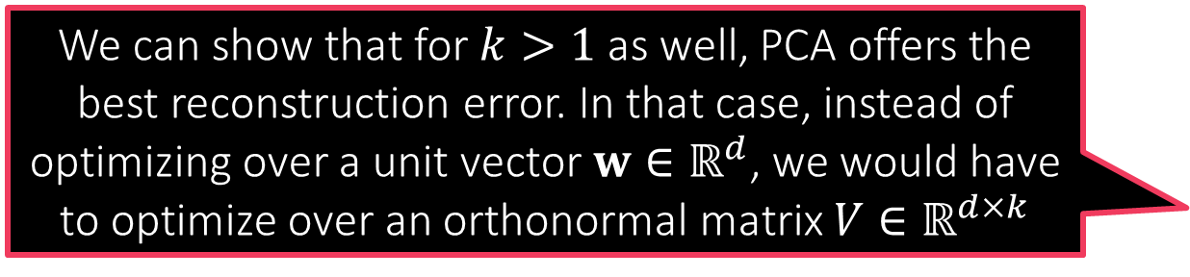
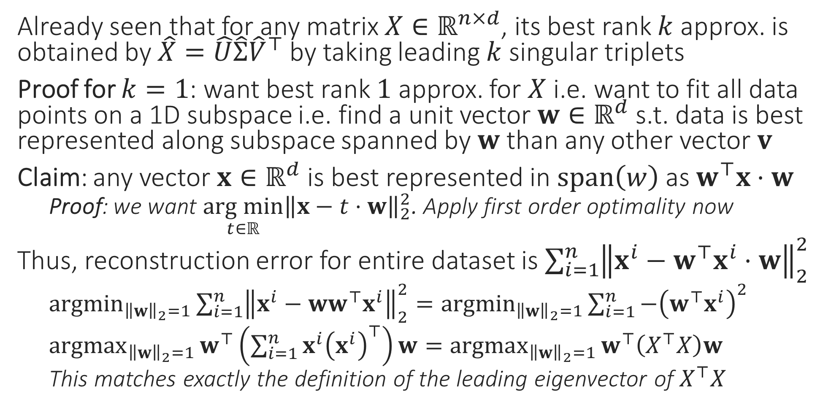
PCA Minimizes Reconstruction Error
We can show that for $k>1$ as well, PCA offers the best reconstruction error. In that case, instead of optimizing over a unit vector $w∈ℝ^{d}$, we would have to optimize over an orthonormal matrix $V∈ℝ^{d×k}$
Already seen that for any matrix $X∈ℝ^{n×d}$, its best rank $k$ approx. is obtained by $\hat{X}=\hat{U}\hat{Σ}{\hat{V}}^{⊤}$ by taking leading $k$ singular triplets
Proof for $k=1$: want best rank $1$ approx. for $X$ i.e. want to fit all data points on a 1D subspace i.e. find a unit vector $w∈ℝ^{d}$ s.t. data is best represented along subspace spanned by $w$ than any other vector $v$
Claim: any vector $x∈ℝ^{d}$ is best represented in $span\left(w\right)$ as $w^{⊤}x⋅w$
Proof: we want $\underset{t∈ℝ}{arg min}{{\left\|x−t⋅w\right\|}_{2}^{2}}$. Apply first order optimality now
Thus, reconstruction error for entire dataset is $\sum_{i=1}^{n}{{\left\|x^{i}−w^{⊤}x^{i}⋅w\right\|}_{2}^{2}}$
${argmin}_{{\left\|w\right\|}_{2}=1}{\sum_{i=1}^{n}{{\left\|x^{i}−{ww}^{⊤}x^{i}\right\|}_{2}^{2}}}={argmin}_{{\left\|w\right\|}_{2}=1}{\sum_{i=1}^{n}{−{\left(w^{⊤}x^{i}\right)}^{2}}}$
${argmax}_{{\left\|w\right\|}_{2}=1}{w^{⊤}\left(\sum_{i=1}^{n}{{x^{i}\left(x^{i}\right)}^{⊤}}\right)w}={argmax}_{{\left\|w\right\|}_{2}=1}{w^{⊤}\left(X^{⊤}X\right)w}$
This matches exactly the definition of the leading eigenvector of $X^{⊤}X$

Slide 26

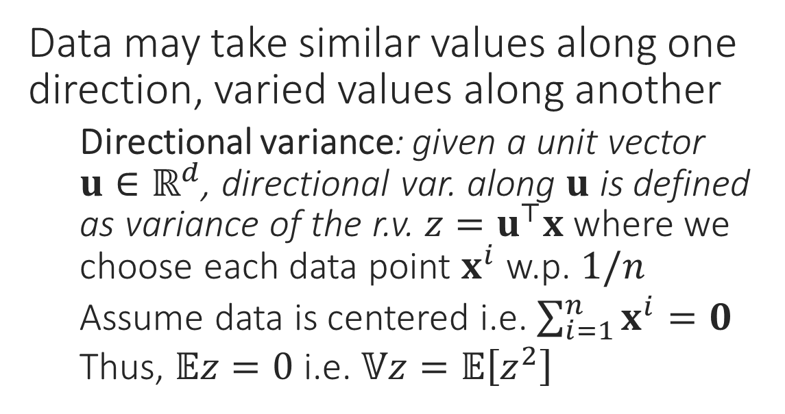
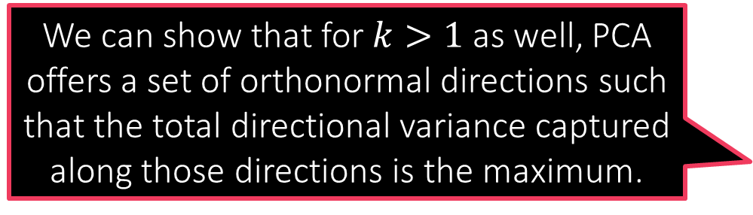
PCA Preserves Maximum Data Variance
Data may take similar values along one direction, varied values along another
Directional variance: given a unit vector $u∈ℝ^{d}$, directional var. along $u$ is defined as variance of the r.v. $z=u^{⊤}x$ where we choose each data point $x^{i}$ w.p. $1/n$
Assume data is centered i.e. $\sum_{i=1}^{n}{x^{i}}=0$
Thus, $𝔼z=0$ i.e. $𝕍z=𝔼\left[z^{2}\right]$
Projecting onto this line throws away a lot of information about the data ☹
Directions with more directional variance preserve more info
PCA does give us orthonormal directions with largest directional variance
$𝔼\left[z^{2}\right]=\frac{1}{n}\sum_{i=1}^{n}{{\left(u^{⊤}x^{i}\right)}^{2}}=\frac{1}{n}u^{⊤}\left(X^{⊤}X\right)u$
Thus, finding the direction offering the maximum directional variance is the same as finding the leading right singular vector
We can show that for $k>1$ as well, PCA offers a set of orthonormal directions such that the total directional variance captured along those directions is the maximum.

Slide 27
Deep Learning

Slide 28

From Kernel Learning to Deep Learning
Notice that kernel learning essentially involves learning a linear model over new features. The new features are given by the kernel map $φ_{K}$
The num of features is large (infinite?) which causes kernel algos to be slow
Several techniques to speed up kernel methods address this exact problem
Given a budget $k$ can we directly learn $k$ good features?
In some sense, deep learning does exactly this
Several deep networks basically run a linear ML algo on top of learnt features
Key difference: instead of first learning good features and then learning a linear model on top of those features, deep learning learns both jointly
Drawbacks: non-convex problem, over parameterized, can be bulky/slow

Slide 29








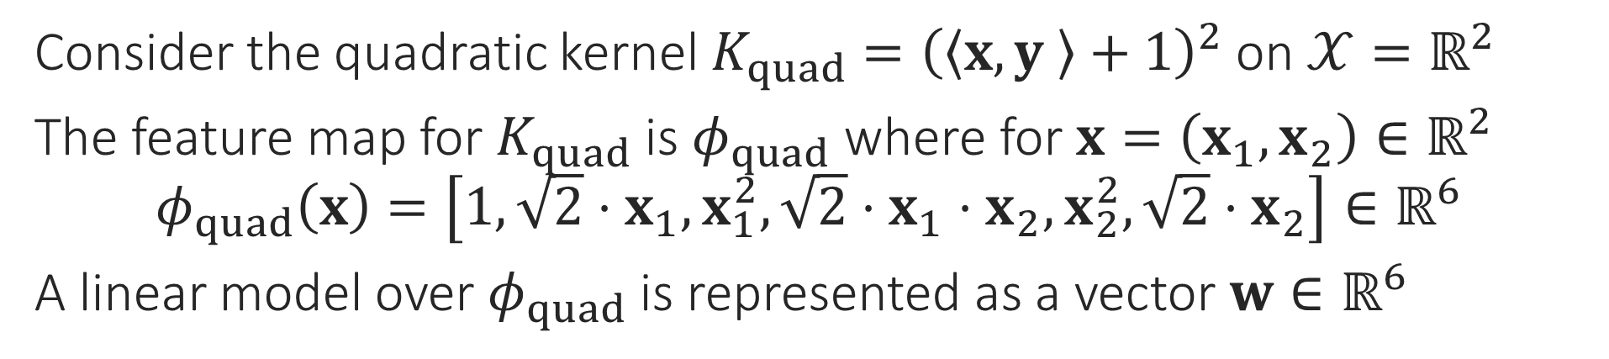








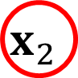



Kernel Learning viewed as Deep Learning
Consider the quadratic kernel $K_{quad}={\left(\left\langle x,y \right\rangle +1\right)}^{2}$ on $𝒳=ℝ^{2}$
The feature map for $K_{quad}$ is $φ_{quad}$ where for $x=\left(x_{1},x_{2}\right)∈ℝ^{2}$ $φ_{quad}\left(x\right)=\left[1, {\sqrt{2}⋅x}_{1}, x_{1}^{2},\sqrt{2}⋅x_{1}⋅x_{2}, x_{2}^{2},\sqrt{2}⋅x_{2}\right]∈ℝ^{6}$
A linear model over $φ_{quad}$ is represented as a vector $w∈ℝ^{6}$
A 3 layer network
Training kernel SVM/kernel RR tunes these weights
$$\left\langle w,φ_{quad}\left(x\right)\right\rangle$$
Input/ouput (or “I/O”) layers are called “visible”
$$+$$
Output layer
$$w_{1}$$
$$w_{6}$$
$$w_{2}$$
$$w_{3}$$
$$w_{4}$$
$$w_{5}$$
$$1$$
$$id$$
$$sq$$
$$×$$
$$sq$$
$$id$$
“Hidden” layer Usually many of these
$$\sqrt{2}$$
$$\sqrt[4]{2}$$
$$\sqrt[4]{2}$$
$$\sqrt{2}$$
$$x_{1}$$
$$x_{2}$$
Input layer

Slide 30












The “Neuron” in Deep/Neural Networks
Output
Output layer: final o/p Input/hidden layer: o/p to other neurons
A network with no hidden layer is just a generalized linear model, also called a perceptron
Activation
Input layer: always id
Output layer: id/softmax/sign etc
Hidden layer: non-linear e.g. ReLU
$$y$$
$$y=f\left(\sum_{i=1}^{d}{w_{i}⋅x_{i}}\right)$$
$$f$$
Input
Input layer: no i/p
Hidden/output layer: i/p taken from other neurons
$$Σ$$
$$w_{1}$$
$$w_{d}$$
$$…$$
Some input items can be bias terms (constant) e.g. 1
$$w_{2}$$
$$x_{1}$$
$$x_{2}$$
$$…$$
$$x_{d}$$

Slide 31
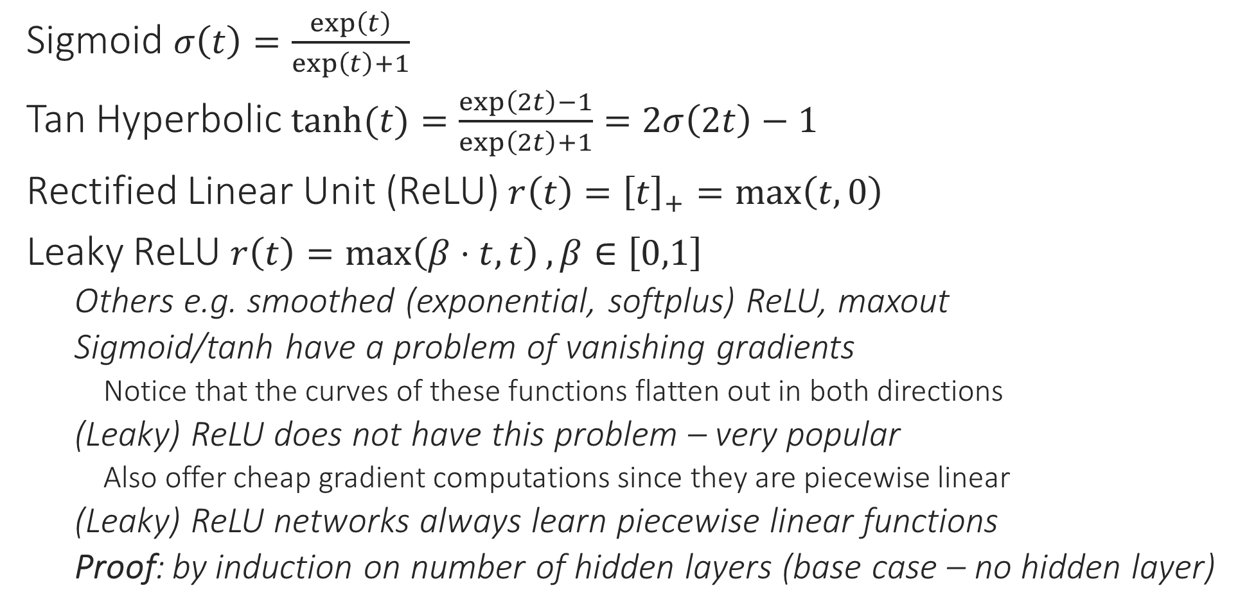
Common Activation Functions
1
1
0.5
Sigmoid $σ\left(t\right)=\frac{\exp\left(t\right)}{\exp\left(t\right)+1}$
Tan Hyperbolic $\tanh{(t)}=\frac{\exp\left(2t\right)−1}{\exp\left(2t\right)+1}=2σ\left(2t\right)−1$
Rectified Linear Unit (ReLU) $r\left(t\right)={\left[t\right]}_{+}=\max\left(t,0\right)$
Leaky ReLU $r\left(t\right)=\max\left(β⋅t,t\right),β∈\left[0,1\right]$
Others e.g. smoothed (exponential, softplus) ReLU, maxout
Sigmoid/tanh have a problem of vanishing gradients
Notice that the curves of these functions flatten out in both directions
(Leaky) ReLU does not have this problem – very popular
Also offer cheap gradient computations since they are piecewise linear
(Leaky) ReLU networks always learn piecewise linear functions
Proof: by induction on number of hidden layers (base case – no hidden layer)
0
0
1
-1
1
0
0
-1
Output layer neurons are usually given a task-specific activation e.g. identity for regression problems, sign for binary/multilabel classification problems, softmax for multiclassification problems

Slide 32
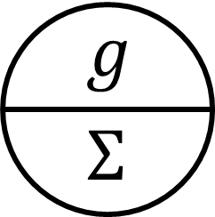


















Toy Example
Input sent to first hidden layer with two nodes
Each node first computes its pre-activation value $a_{i}={\left(w^{i}\right)}^{⊤}x,i=1,2,w^{i},x∈ℝ^{d}$
Non-linear activation applied to each preactivation
$$h_{i}=f\left(a_{i}\right),i=1,2$$
The vector $h∈ℝ^{2}$ sent to next layer as input
Process of preactivation, activation etc repeats
Shorthand: let $W=\left[w^{1},w^{2}\right]∈ℝ^{d×2}$
Function computed by this network is $g\left(v^{⊤}f\left(W^{⊤}x\right)\right)$
This nesting of functions gives DN their power
$$v_{1}$$
$$v_{2}$$
$$h_{1}$$
$$h_{2}$$
$$a_{1}$$
$$a_{2}$$
$$w_{12}$$
$$w_{13}$$
$$w_{21}$$
$$w_{22}$$
$$w_{11}$$
$$w_{23}$$
$$x_{1}$$
$$x_{2}$$
$$x_{3}$$

Slide 33








Feedforward Deep Networks
Some networks do allow “skip”, “feedback” connections, others allow activation fn $f$ to change from layer to layer
This architecture is often called a Multi-layered perceptron
$$f$$
$$f$$
One output node needed for binary classfn, regresn, more for multi-label/class
$$W$$
Cannot skip layers in classical FF networks
No “reverse” links allowed
$$V$$
Connections b/w layers usually “dense” – all pairs connected
$$U∈ℝ^{3×6}$$
$$V∈ℝ^{6×5}$$
$$W∈ℝ^{5×2}$$
$$U$$
All weights are learnt
$$f\left(W^{⊤}f\left(V^{⊤}f\left(U^{⊤}x\right)\right)\right)$$

Slide 34
Feedforward Deep Networks
$$f$$
$$f$$

Slide 35


Deep Networks
Strictly speaking, NN are parameterized models (connection weights are the parameters) but, they are frequently over parameterized – millions of parameters so almost as good (bad) as non-parametric – bulky models, long train + test times
Output layer
The layered architecture is what makes deep networks “deep”
Lower layers can be interpreted as computing useful features
Networks that learn polynomial etc features exist too – Sum Product Networks (SPN)
Last layer exploits all this hard work to learn a good linear model over them – can have any no. of layers, any no. of nodes in each layer
Kernels throw a large (often infinite) number of features at a problem, deep networks instead try to learn a small number of problem specific features
Easier said that done though ☺
A network having a linear activation function in hidden layers is useless since such a network can only learn a linear function in input
Can collapse, replace all hidden layers with a single connection from i/p to o/p
Even (leaky) ReLU are piecewise linear, not linear – non-linearity is essential
Hidden layer
$$φ\left(x\right)$$
Hidden layer
Input layer

Slide 36

Deep Networks Learn Features
We know what are expected outputs of the o/p layer (they are the train labels). So we say that the o/p layer is “visible”
Hidden representations make it easier for a linear model to perform well
Hidden layers compute latent or “hidden” representations not supplied with train data
Input layer is fed with train features which are also “visible” in train data

